Slide 1
Radical Candor by Kim Scott
Emily Atkins

Slide 2
Objectives
The aim of this session is to learn how to engage in healthy conflict and apply it positively.
To do this, we will cover:
What is feedback and why do we need it?
What is Radical Candor?
        3. What are the four quadrants of Radical Candor?
        4. How can you apply Radical Candor?

Slide 3

What is feedback?
Feedback is the process of giving constructive information or advice based on performance, behaviour, or skills in the workplace.

Slide 4

Why do we need feedback?
82% of employees don’t feel that their supervisors recognise them enough for their contributions.
40% of employees say they’d put more energy into their work if they were recognised more often.
Why do we need to learn how to deliver feedback?
69% of managers are often uncomfortable communicating with employees.
37% said they’re uncomfortable having to give direct feedback about their employees’ performance if they think the employee might respond negatively to the feedback.

Slide 5
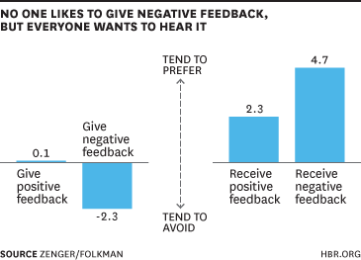
Feedback and Team Performance
In one study, researchers found that managers account for at least 70% of the variance in employee engagement.
72% of people said their performance would improve if their managers would provide corrective feedback.
Another study found that recognising and appreciating your employees increases productivity, engagement, and performance by up to 14%.
What could we achieve if every member of the team practised radical candor?
Notes:
How do you think feedback improves team performance?
Open question to the room.
Who needs feedback?
Who’s role is it to give feedback?
14% conducted by Interact
Zenger/Folkman found that - 72% and 70%
https://officevibe.com/blog/shocking-statistics-manager-needs-know

Slide 6

What is Radical Candor?
It’s NOT being brutally honest, regardless of consequences.
Radical Candor is about delivering all feedback whilst considering someone else’s feelings and fostering an open and candid communication culture.
Radical candor is feedback you give that is kind, clear, specific and sincere.
Notes:
What do you think Radical Candor means? – to the room.
End of slide – what do you think about that?
How much do you like that person and respect their being ‘brutally honest’
Get to know your team on a personal level, understand their aspirations, challenges, and interests.
Show empathy and genuine concern for their well-being, both inside and outside of work.
For people to trust your intent, they need to be able to trust you.
Challenge:
While caring personally is essential, it's equally important to challenge your team directly.
Provide honest and constructive feedback without sugar-coating or avoiding difficult conversations.
Focus on the behaviour or performance, not the individual, and be specific in your feedback.
Vulnerability –
Are you snapping at the desk? – are you under stress? Don’t be afraid to tell people in advance that you are having a bad day
Challenge directly shows you care – you share your opinion knowing that what you say is not gospel
Ideally, first build a relationship with anyone before giving them feedback. Make sure they know you care personally about them and their career.
Then be extremely candid and clear with your critical feedback. Leave no room for interpretation.

Slide 7
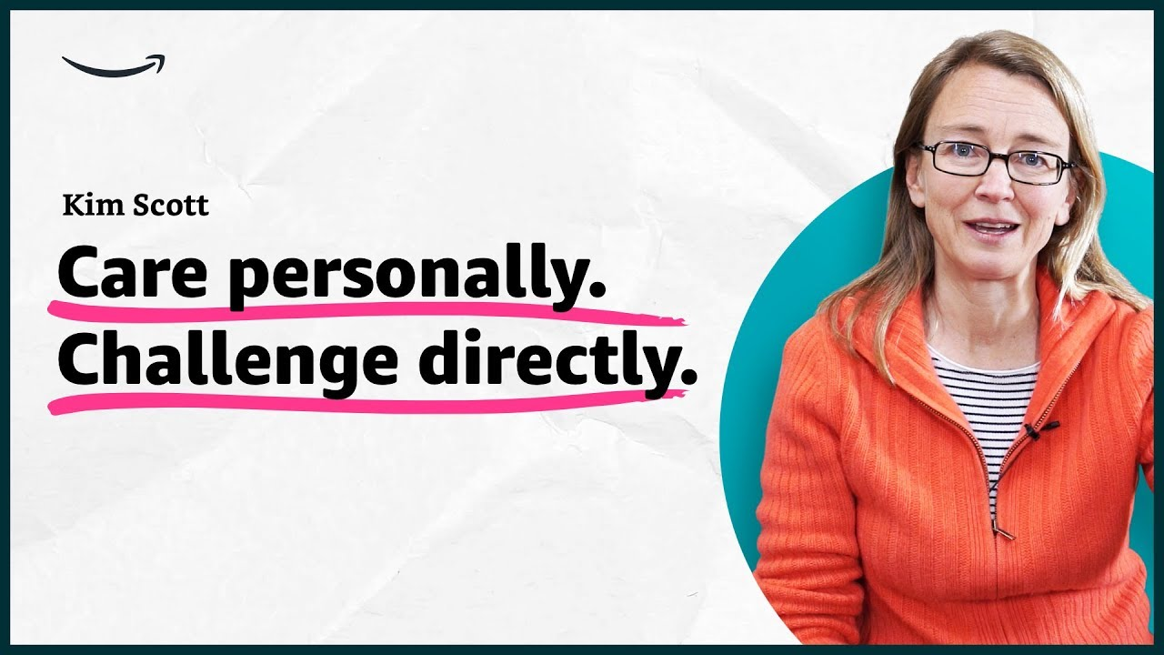
What are the foundations of Radical Candor?
Notes:
What does this mean? Open question to the group

Slide 8
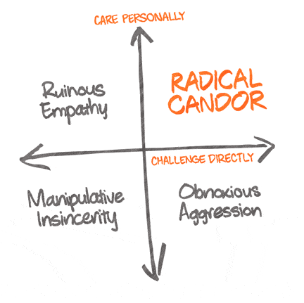
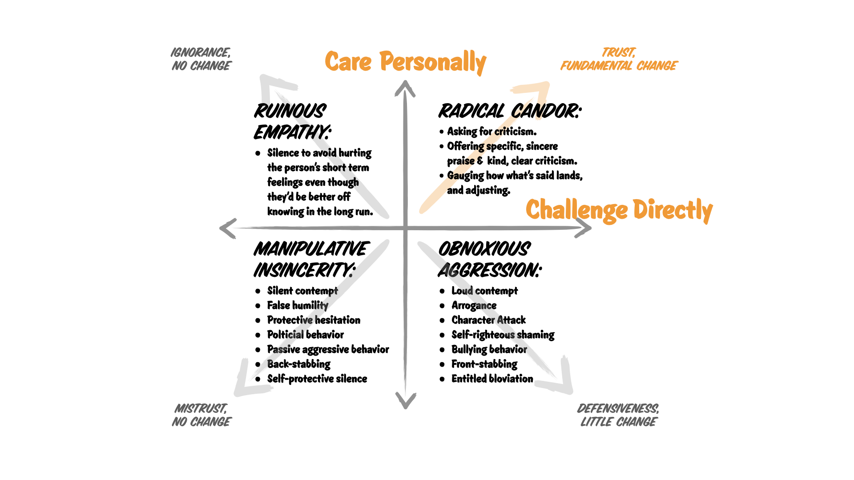
What are the Four Quadrants of Radical Candor?
Notes:
Managers often fall into the traps of Ruinous Empathy or Obnoxious Aggression.
Ruinous Empathy avoids giving honest feedback to spare someone's feelings, leading to stagnant growth.
Obnoxious Aggression involves being brutally honest without showing genuine care, leading to demotivated teams.
Be aware of your own biases and how they may impact your ability to practice Radical Candor.
Obnoxious Aggression, also called brutal honesty or front stabbing, is what happens when you challenge someone directly, but don’t show you care about them personally.
It’s praise that doesn’t feel sincere or criticism and feedback that isn’t delivered kindly.
When you criticize someone without taking time to show you care about them personally, your feedback feels obnoxiously aggressive to the recipient.
When managers belittle employees, embarrass them publicly, or freeze them out, their behaviour falls into this quadrant.
Ruinous Empathy is what happens when you want to spare someone’s short-term feelings, so you don’t tell them something they need to know.
It’s praise that isn’t specific enough to help the person understand what was good or criticism that is sugar-coated and unclear. Or simply silence.
Ruinous Empathy may feel nice or safe, but is ultimately unhelpful and even damaging.
Manipulative Insincerity is praise that is insincere, flattery to a person’s face and harsh criticism behind their back. THE PEOPLE PLEASER
It’s the kind of backstabbing, political, passive-aggressive behavior that might be fun to tell stories about but makes for a toxic workplace, ruining relationships and ruining work.
For positive feedback, be just as specific. Otherwise you’re just being insincere.
Manipulatively insincere feedback happens when you don’t care enough about a person to challenge directly.

Slide 9
Where do you sit on the quadrants in different areas?
Personal life
Professional
Your team
The wider company
Where could you improve?
Notes:
Different team/people different quadrant?
Teams you don’t know – care less personally, can lean more aggressive
Where do you sit, vs where to others think you sit?

Slide 10

How do you build a Culture of Radical Candor?
Encourage open feedback and create a safe space for the team.
Lead by example and demonstrate Radical Candor in your interactions.
Provide feedback with the aim to find the right answer, not to be right.
Target the behaviour, not the person.
Be specific, timely, and focused on behaviours, not the individual.
Praise publicly, criticise in private – don’t reply all!
Notes:
Who do you think in your team is good at Radical Candor?
What do you do that you believe makes you good at this?
Encourage open feedback and create a safe space for team members to express their concerns. You can use one-on-one meetings to provide feedback, discuss career goals, and address concerns.
Create an environment where team members feel empowered to provide feedback to their managers.
Use failures and mistakes of the team and yourself, as opportunities for growth and learning.
Take on board and consider others’ feedback. This will help them take it too.
Acknowledge and appreciate feedback from your team – whether you action or not!
Set the standard for open communication and a caring attitude – BE VULNERABLE
Resolve issues promptly and constructively.
Vulnerability –
Are you snapping at the desk? – are you under stress? Don’t be afraid to tell people in advance that you are having a bad day
Challenge directly shows you care – you share your opinion knowing that what you say is not gospel
Ideally, first build a relationship with anyone before giving them feedback. Make sure they know you care personally about them and their career.
Then be extremely candid and clear with your critical feedback. Leave no room for interpretation.

Slide 11
How could you make the below feedback more ‘Radically Candid’?
“You did a good job but you said “um” a lot during the presentation so you sounded stupid"
“You didn’t sound professional on the phone just now, do better”
"Try harder next time"
“You did a good job in your presentation, well done”
Target the behaviour, not the person!
Specifics! What didn’t work and what could be done next time?
Context – what was done well and what made it good?
Care Personally
Challenge Directly
Notes:
Don’t’ use the word ‘but’

Slide 12

"Radical Candor" by Kim Scott offers valuable insights into effective leadership and building strong team relationships.
By combining care and challenge, teams can create an environment of Radical Candor, leading to improved team dynamics and exceptional results.
What have we covered?
Care Personally and Challenge Professionally.
The Four Quadrants of Radical Candor.
How to build a culture of Radical Candor.

Slide 13

What is your main takeaway?

Slide 14
Questions?

